Slide 1



@torokagoston agostontorok.github.io @tony_does_science

Slide 2
hello.
Notes:
Let me start this talk in a little peculiar way, namely with an anouncement. We are introducing today the new phone 8

Slide 3
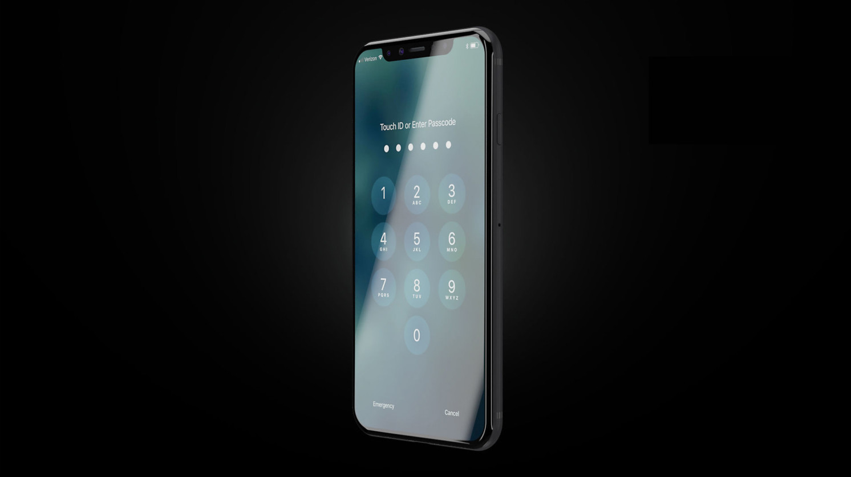
Phone 8
Better camera
Better features
Longer battery life
Larger screen

Slide 4
Phone 8
Better camera
Better features
Longer battery life
Larger screen
Notes:
https://www.google.hu/search?safe=off&biw=1422&bih=655&tbm=isch&sa=1&q=phone+in+pocket&oq=phone+in+pocket&gs_l=psy-ab.3..0i19k1l3j0i7i30i19k1.3551.5000.0.5321.5.4.1.0.0.0.94.310.4.4.0....0...1.1.64.psy-ab..0.5.315.cbP1kyb1E3o

Slide 5
The neuroscience of virtual reality​
Notes:
I’ve always considered myself more of an applied scientist, interested in problems that would make people’s life easier, better and happier

Slide 6
VR is ..

Slide 7
VR is a tech challenge
Notes:
Needs to be cheaper Needs content Needs to be mobile - miniaturization
5g Speed
Prepared society (security)
•Consumers don’t really care about how difficult was the problem that you solved

Slide 8

VR is a tech challenge
Just let me play Angry Birds on my Oculus!
Notes:
Needs to be cheaper Needs content Needs to be mobile - miniaturization
5g Speed
Prepared society (security)
•Consumers don’t really care about how difficult was the problem that you solved

Slide 9
VR is ..

Slide 10
VR is the key to everything
Notes:
Needs to be cheaper Needs content Needs to be mobile - miniaturization
5g Speed
Prepared society (security)
•Consumers don’t really care about how difficult was the problem that you solved

Slide 11
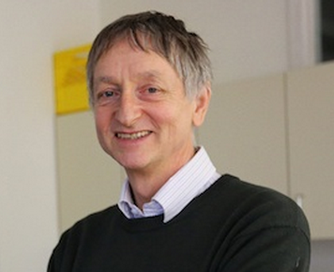
VR is the key to everything
Of course not, deep learning is!
Notes:
Needs to be cheaper Needs content Needs to be mobile - miniaturization
5g Speed
Prepared society (security)
•Consumers don’t really care about how difficult was the problem that you solved

Slide 12
VR is ..

Slide 13
VR is sg. I should invest in
Notes:
Needs to be cheaper Needs content Needs to be mobile - miniaturization
5g Speed
Prepared society (security)
•Consumers don’t really care about how difficult was the problem that you solved

Slide 14
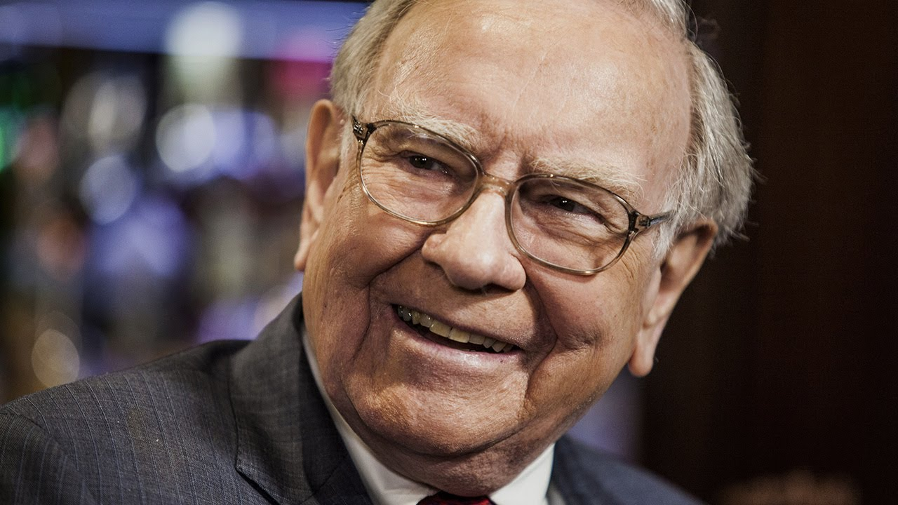
VR is sg. I should invest in
So you’ve got a hot tip for me?
Notes:
Needs to be cheaper Needs content Needs to be mobile - miniaturization
5g Speed
Prepared society (security)
•Consumers don’t really care about how difficult was the problem that you solved

Slide 15
VR is ..

Slide 16
VR is the new interface.
Notes:
Needs to be cheaper Needs content Needs to be mobile - miniaturization
5g Speed
Prepared society (security)
•Consumers don’t really care about how difficult was the problem that you solved

Slide 17
VR is the new interface.
Notes:
Needs to be cheaper Needs content Needs to be mobile - miniaturization
5g Speed
Prepared society (security)
•Consumers don’t really care about how difficult was the problem that you solved

Slide 18
VR is the new interface.
Intuitive
Notes:
Needs to be cheaper Needs content Needs to be mobile - miniaturization
5g Speed
Prepared society (security)
•Consumers don’t really care about how difficult was the problem that you solved

Slide 19
VR is the new interface.
Intuitive
Organic
Notes:
Needs to be cheaper Needs content Needs to be mobile - miniaturization
5g Speed
Prepared society (security)
•Consumers don’t really care about how difficult was the problem that you solved

Slide 20
VR is the new interface.
Intuitive
Organic
Unconstrained
Notes:
Needs to be cheaper Needs content Needs to be mobile - miniaturization
5g Speed
Prepared society (security)
•Consumers don’t really care about how difficult was the problem that you solved

Slide 21

in·tu·i·tive ​
intuitive​
\in-ˈtü-ə-tiv, -ˈtyü-\​
adjective
known or perceived by intuition : directly apprehended
readily learned or understood

Slide 22
Look at oculus

Slide 23
and woman

Slide 24
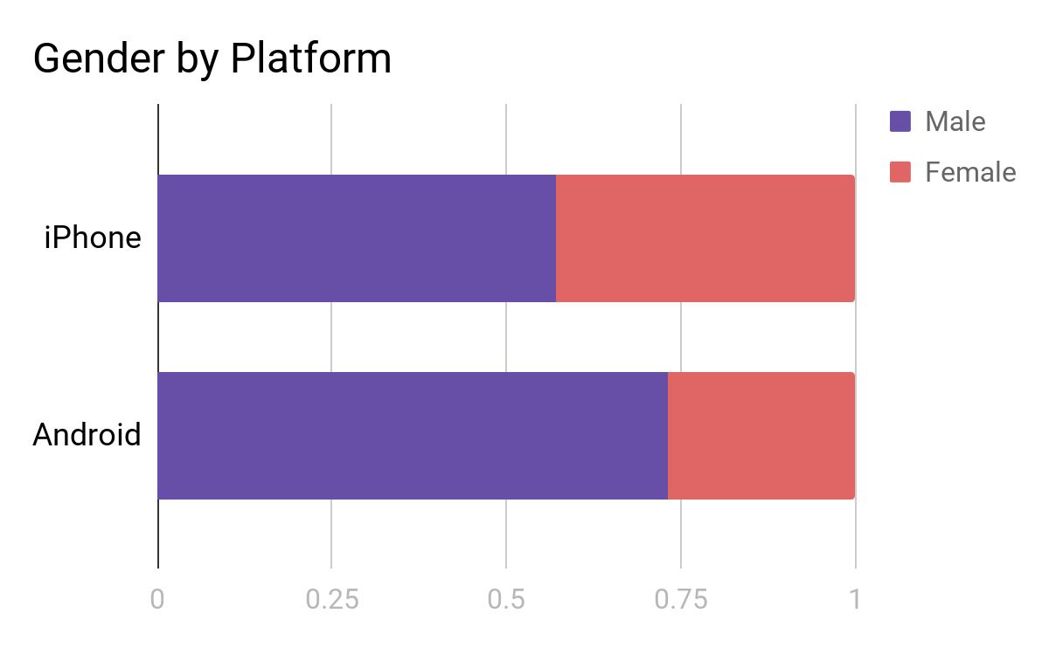
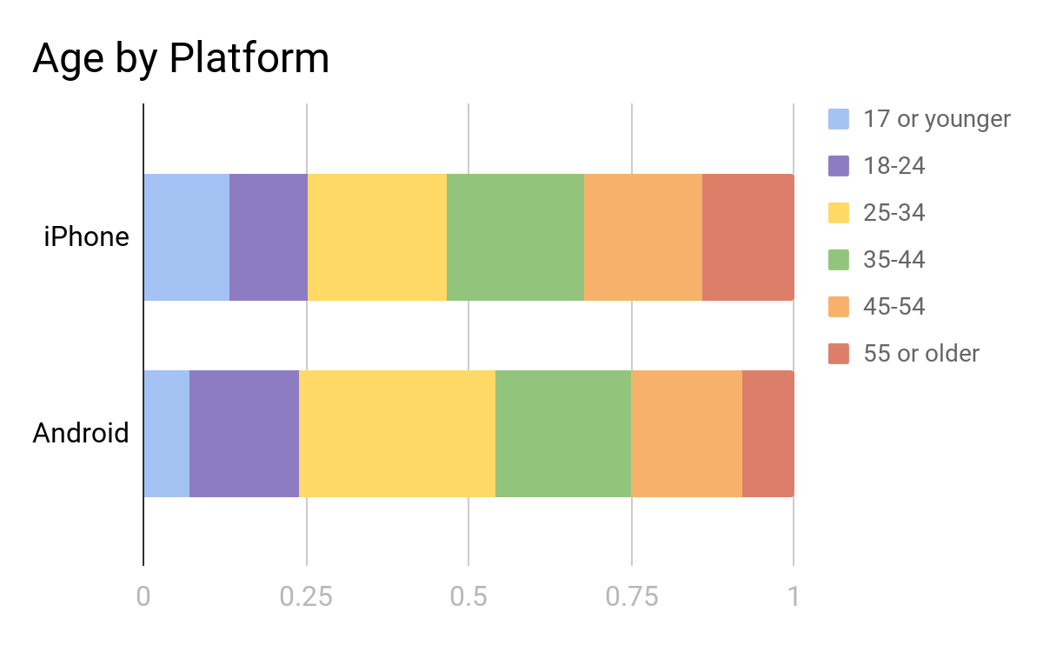
Early adopters
source admob

Slide 25
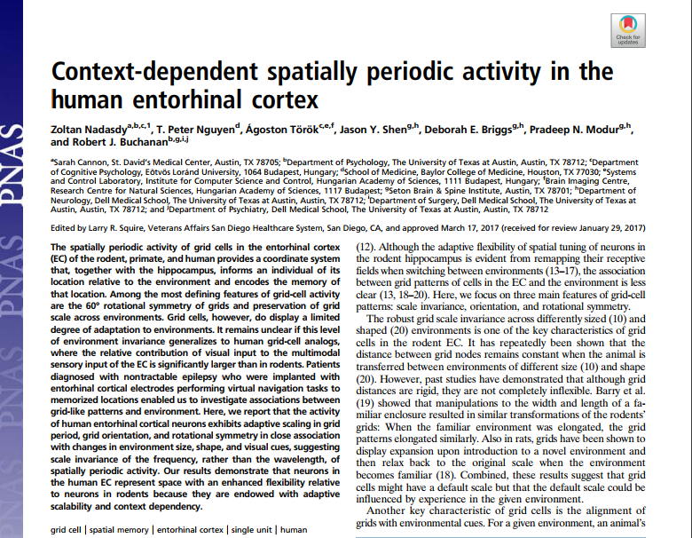
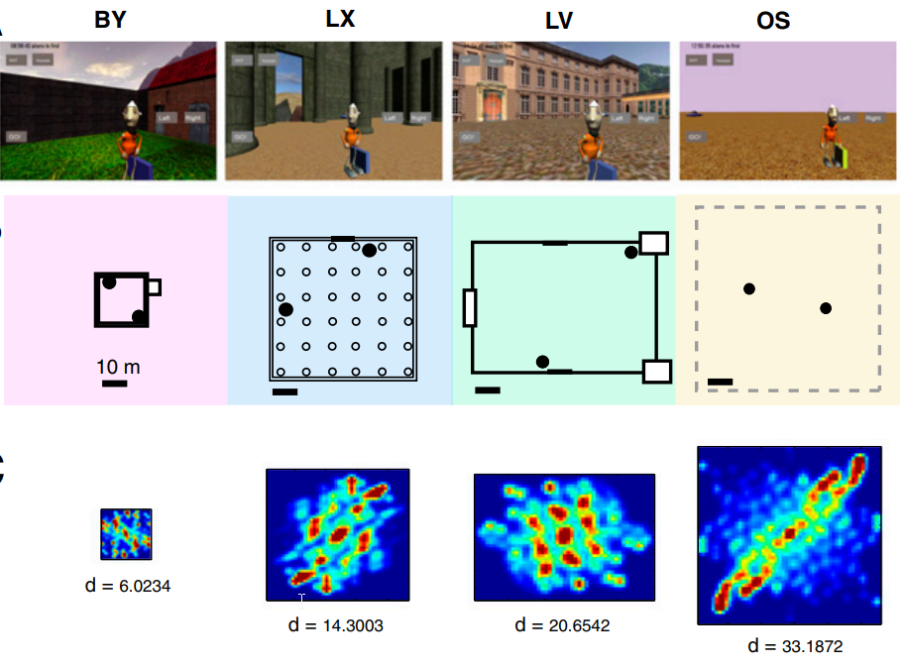
Grid cells adapt to environment size in humans
Notes:
Online pdf

Slide 26
and woman

Slide 27
show the other players

Slide 28
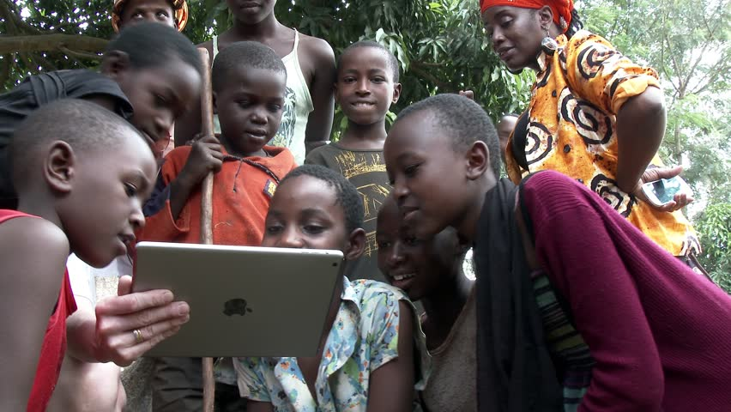
Notes:
Show the game
Picture of me showing the game to my grandma
Family - developmental aspects
The question of interaction
You should never spend time on inventing the wheel
What should you show

Slide 29
“...think about lifting your right arm if you want to move forward…”

Slide 30
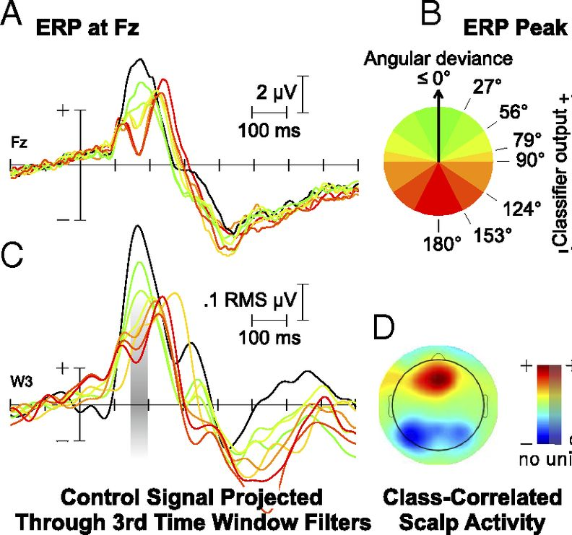
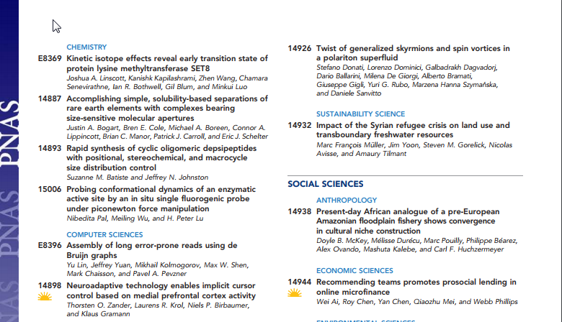
Zander et al. PNAS 2016
Notes:
Online pdf

Slide 31
focus on finding the wheel
instead of reinventing it

Slide 32
or·gan·ic ​
organic​
\ȯr-ˈga-nik\​
adjective
relating to, or arising in a bodily organ
relating to, or derived from living organisms
forming an integral element of a whole

Slide 33
close your eyes, please

Slide 35
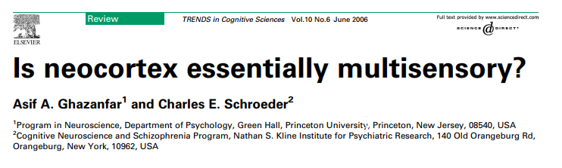
Notes:
Online pdf

Slide 36
so much ...
Notes:
That even what we believe is unisensory is actually multisensory

Slide 37
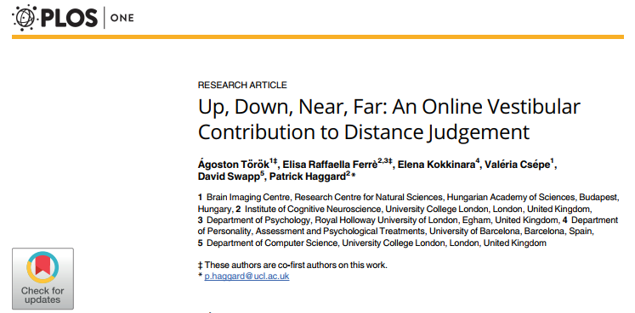
Notes:
Online pdf

Slide 38
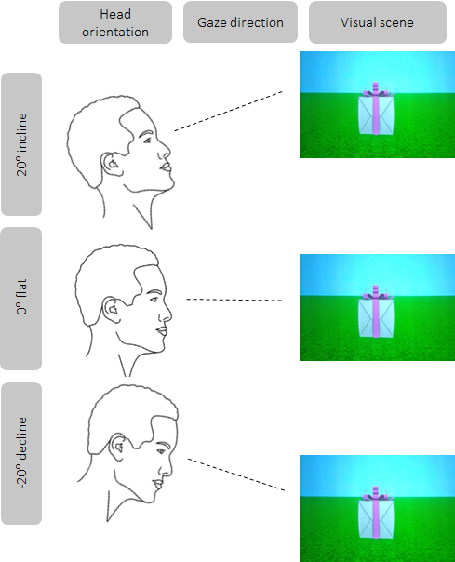
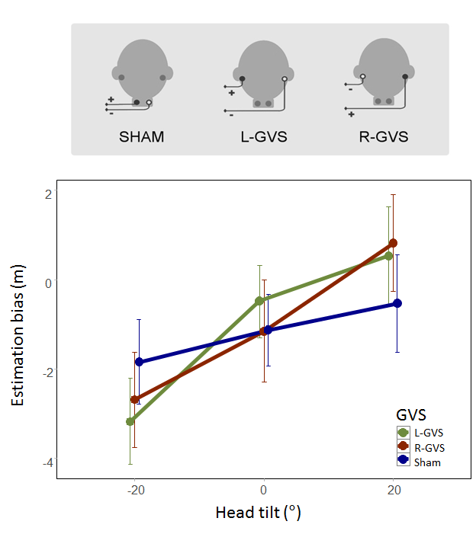

Slide 39
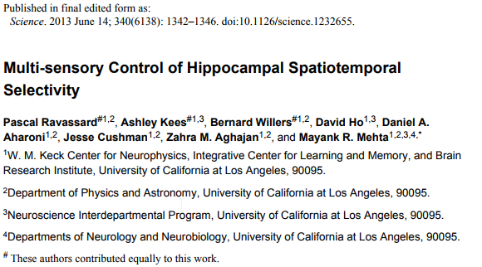

Slide 40
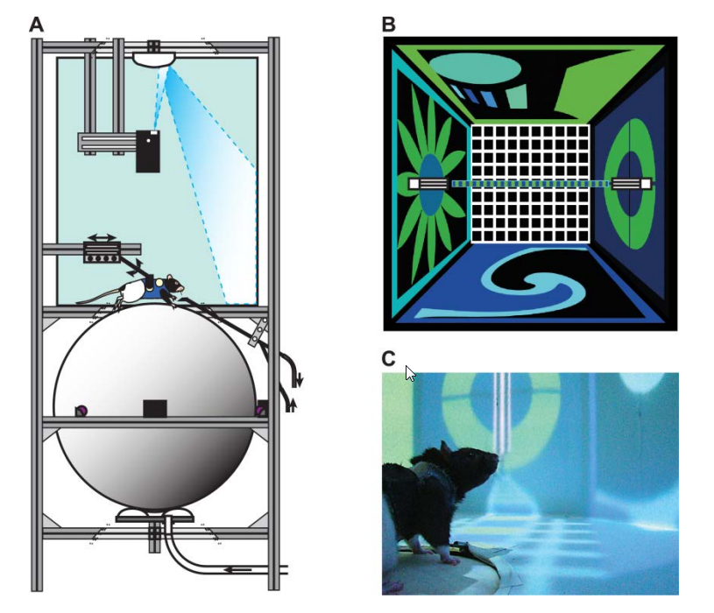

Slide 41
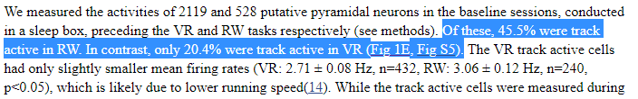

Slide 42
going fully virtual?

Slide 43
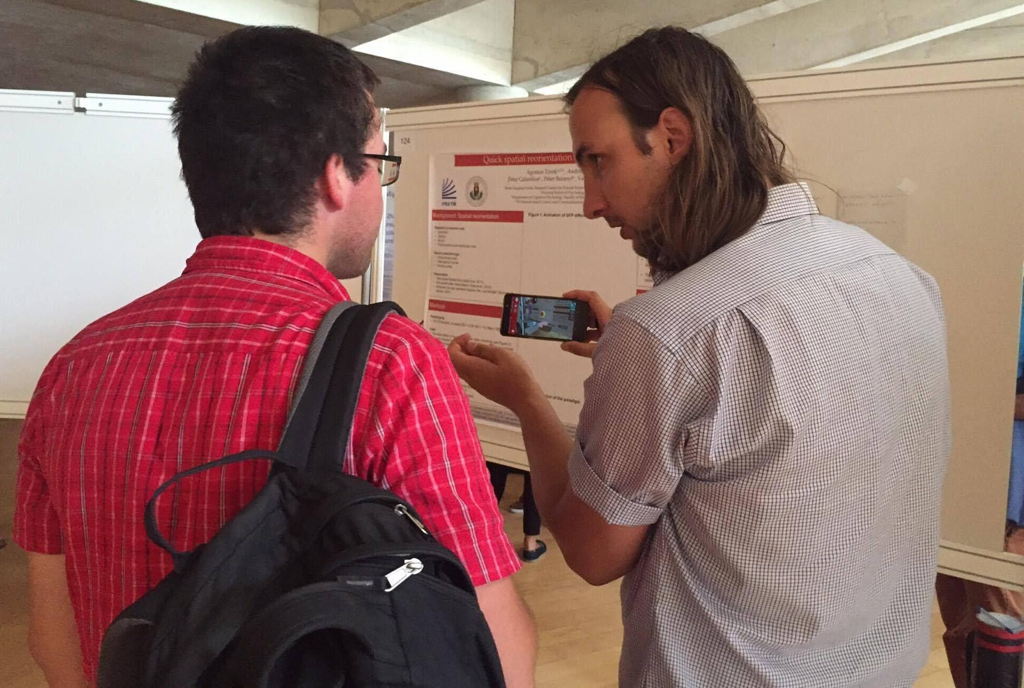
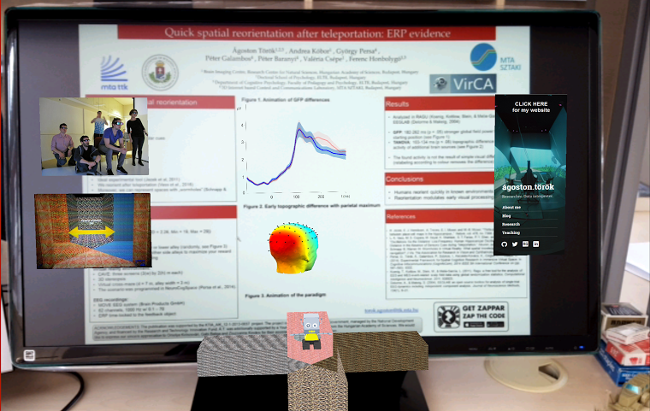
Notes:
Talk about Magic Leap

Slide 44
more than meets the eyes

Slide 45
un·con·strained ​
unconstrained​
\ˌən-kən-ˈstrānd\
adjective
not held back or constrained
not restricted or limited

Slide 46

Notes:
In order to create a radically new and better interface we have to think outside the box, and sometimes even forget that there was ever any box

Slide 48
old habits die hard

Slide 49
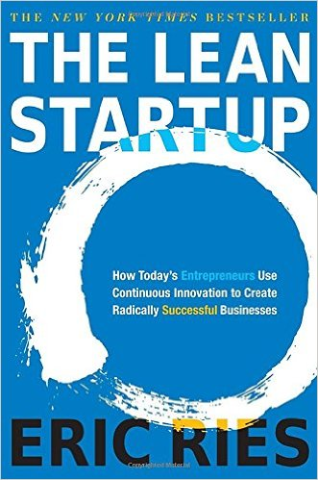

Slide 50



Slide 51
Start in south

Slide 52
Turn left

Slide 53
Teleport to North

Slide 54
Turn right

Slide 55
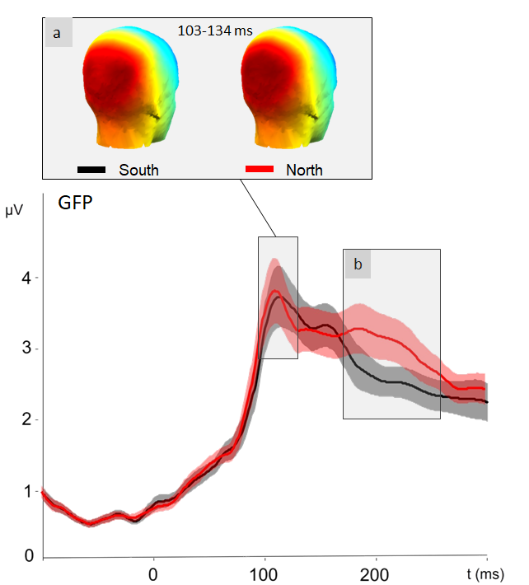
Notes:
Show the experiment

Slide 56
conclusions.

